Slide 1

20EC2214-IoT Design Workshop
2021-2022 Even Sem
End Sem Project Review

Slide 2

IoT Based Color Sorting Machine using ESP8266 and Thing speak
V.V.JATHIN GUPTHA 2000040153 SEC-2(D)
K.HARSHA VARDHAN 2000040183 SEC-2(D)

Slide 3
CONTRIBUTION
V.V.JATHIN GUPTHA------>PPT& PROJECT REPORT
K.HARSHA VARDHAN------->Project Demonstration

Slide 4
ABSTRACT
Now days finding parking in busy areas is very hard and there is no system to get the details of parking availability online. Imagine if you can get the parking slot availability information on Lcd screen and you don’t have roaming around to check the availability. This problem can be solved by the IoT based smart parking system. Using the IoT based parking system you can easily access the parking slot availability over the internet. This system can completely automate the car parking system. From your entry to the payment and exit all can be done automatically.
So here we are building an IOT based Car Parking System using NodeMCU, sensors, and two motors. Two sensors are used at entry and exit gate to detect the car while three sensors are used to detect the parking slot availability. motors are used to open and close the gates according to the sensor value.

Slide 5

INTRODUCTION
The aim of the project is to design, develop and build an IoT based Smart Parking System using Node-MCU ESP8266 with growing quality of good Cities. There's forever a requirement for good solutions for each domain. The IoT has enabled the likelihood of good Cities with it’s over the net management feature. Someone will manage the devices put in in his home or workplace from any place within the world by simply checking a Smartphone or any net connected devices. There are unit multiple domains during a good town and good Parking is one amongst the favored domains within the good town..
The Node-MCU is an open-source firmware and development kit that helps you to Prototype your product within a few Lua script lines. ESP8266 has powerful on-board processing and storage capabilities that allow it to be integrated with the sensors specific devices through its GPIOs with minimal development up-front and minimal loading during runtime.
IR sensors are used to detect if someone is crossing the street or not. It detects the obstacle or motion in the surrounding. The transmitter will transmit IR rays which will be reflected back if it falls on some object like person, animal, vehicles, etc. The reflected ray will be received by receiver diode and hence will confirm the presence of object and the corresponding LED will be glowed. This method will save significant amount of electricity as the street light will only turns on if there is someone present in the Street. IR sensor has 3 pins, two of which are VCC and ground and one is output pin. The output of IR sensor gets high if detects presence of some object. This pin is connected to GPIO pin of NodeMCU so whenever the IR sensor detects someone passing through the street it triggers the Street light. In our case one LED will be turned on.

Slide 6
COMPONENTS REQUIRED
Hardware
NodeMCU ESP8266
TCS34725
Servo Motor - (2)
Micro USB cable
Jumper wires
Software
Arduino IDE (esp8266 library installed)
ThingSpeak

Slide 7
Specifications of TCS3200 RGB Colour Sensor
This module has a working voltage of 3V to 5V which means it can be directly interfaced with any microcontroller, and that is why it’s a perfect choice for our Node MCU, which uses a 3.3V logic level. Other than power and ground, it has an enable pin E0, by pulling it low or high, we can disable or enable the chip. The OUT pin is used to provide the output frequency, the S0 and S1 select lines select the output frequency scaling. The S2 and S3 select lines select the photodiode type. After measuring a colour wavelength, it outputs the result as frequency, so we can directly measure the frequency and determine the colour, which reduces the intervention of an ADC. And finally, this sensor can accurately measure a test object within a distance of 1cm. If you want to learn more about its specification ​

Slide 8
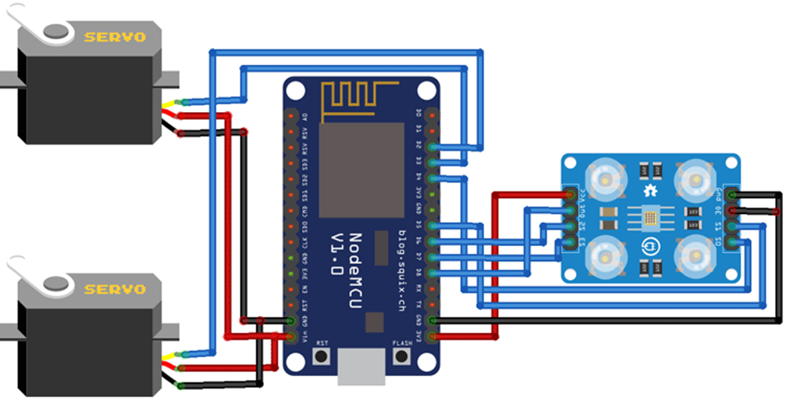
Circuit Diagram for our Colour Sorting Machine

Slide 9
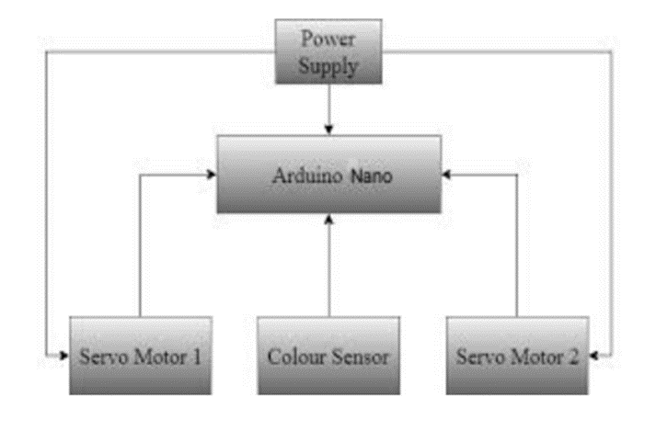
Sorting Mechanism

Slide 10

WORKING:
We will be using ThingSpeak with Arduino IDE, so as usual, the first step will be including all the required libraries. Thingspeak.h library can be downloaded from the link given. The Colour sensor can work without the library as we can read the colour frequency directly from the sensor pin to decide the colour.
After that, in the next lines, we define the ThingSpeak API key, channel number, Wi-Fi name, and password, which we have previously saved while making the ThingSpeak account.
Then define the servo variables. Here we are using two servo motors. The first servo motor is used to move the colour balls from the initial position to the colour sensor. The second servo motor is used to drop the colour ball into the colour bucket.
Inside the setup() function, we initialize the Serial at 9600 baud. Then define the colour sensor pins as output pins to read the frequency values also define the pins for top and bottom servo motors.
Inside the loop() function, we measure the incoming frequency of Red, Green, and Blue colour and compares these frequency readings to detect colour. The control pins S2 and S3 are used to read the colour frequencies. For example, to read the frequency of red colour, set the two pins to low logic level, to read the Blue colour, set S3 pin HIGH and S2 pin LOW, and to read the Green colour, set S2 to pin HIGH and S3 pin LOW.
After getting the frequency values for Red, Green, and Blue colour, compare these values to detect the colours. Upon detecting a colour, first, move the drop servo with a particular angle to drops the colour ball to its respective box, then move the pick servo to pass the ball. Frequency values for each colour vary with distance and can be customized accordingly. After recognizing the colour, send the number of colour balls detected to Thing Speak.
Once the code and hardware are ready, make a setup for colour sorting and mount both the servo motors and colour sensor
Now upload the code to the NodeMCU-ESP8266 board and your machine is ready to short the balls of different colours. The number of products for each colour will be displayed.
The controller circuit consists of a camera attached to it that detects colour of a small object in front of it. A motor is used to feed an object to the camera chamber. As soon is the colour is detected a signal is sent to the sorter mechanism which uses a motor to position the sorting tube towards respective section. A feeder is then used to push the object towards the tubs so that it gets sorted and next object is pulled in by the feeder. The action details are sent to the IOT server using iotgecko platform to keep track of the number of objects sorted in each section.

Slide 11
Code:-
#include <Servo.h>
#include <ESP8266WiFi.h>
#include <WiFiClient.h>;
#include <ThingSpeak.h>;
const char * myWriteAPIKey = "9B6ILVOYMUSVOADA";
unsigned long myChannelNumber = 691885;
const char *ssid = "Galaxy-M20"; // Enter your WiFi Name
const char *pass = "ac312124"; // Enter your WiFi Password
WiFiClient client;
Servo pickServo;
Servo dropServo;
const int s0 = D4;
const int s1 = D5;
const int s2 = D6;
const int s3 = D7;
const int out = D8;
int red = 0;
int green = 0;
int blue = 0;
int color=0;
int redcolor = 0;
int greencolor = 0;
int orangecolor = 0;
int yellowcolor = 0;
}

Slide 12
int CLOSE_ANGLE = 30; // The closing angle of the servo motor arm
int OPEN_ANGLE = 10; // The opening angle of the servo motor arm
void setup()
{
Serial.begin(9600);
pinMode(s0, OUTPUT);
pinMode(s1, OUTPUT);
pinMode(s2, OUTPUT);
pinMode(s3, OUTPUT);
pinMode(out, INPUT);
digitalWrite(s0, HIGH);
digitalWrite(s1, HIGH);
pickServo.attach(D2);
dropServo.attach(D3);
pickServo.write(30);
dropServo.write(73);
ThingSpeak.begin(client);
Serial.println("Connecting to ");
Serial.println(ssid);
WiFi.begin(ssid, pass);
while (WiFi.status() != WL_CONNECTED)
{
delay(550);
Serial.print(".");

Slide 13
}
Serial.println("");
Serial.println("WiFi connected");
}
void loop()
{
digitalWrite(s2, LOW);
digitalWrite(s3, LOW);
//count OUT, pRed, RED
red = pulseIn(out, digitalRead(out) == HIGH ? LOW : HIGH);
digitalWrite(s3, HIGH);
//count OUT, pBLUE, BLUE
blue = pulseIn(out, digitalRead(out) == HIGH ? LOW : HIGH);
digitalWrite(s2, HIGH);
//count OUT, pGreen, GREEN
green = pulseIn(out, digitalRead(out) == HIGH ? LOW : HIGH);
Serial.print("R Intensity:");
Serial.print(red, DEC);
Serial.print(" G Intensity: ");
Serial.print(green, DEC);
Serial.print(" B Intensity : ");
Serial.print(blue, DEC);
if(red<39 & red>29 & green<93 & green>83 &blue<78 & blue>69){
dropServo.write(73);
delay(700);

Slide 14
redcolor++;
Serial.print("Red");
open1();
delay(200);
close1();
ThingSpeak.writeField(myChannelNumber, 1,redcolor, myWriteAPIKey);
}
if(green<75 & green>65 & blue<68 &blue>60){
dropServo.write(107);
delay(700);
orangecolor++;
Serial.print("Orange");
open1();
delay(200);
close1();
ThingSpeak.writeField(myChannelNumber, 2,orangecolor, myWriteAPIKey);
}
if(red<46 & red>36 & green<46 & green>37){
dropServo.write(132);
delay(700);
greencolor++;
Serial.print("Green");
open1();
delay(200);

Slide 15
close1();
ThingSpeak.writeField(myChannelNumber, 3,greencolor, myWriteAPIKey);
}
if(red<34 & red>25 & green<37 & green>28 & blue<53 & blue>43){
dropServo.write(162);
delay(700);
yellowcolor++;
Serial.print("Yellow");
open1();
delay(200);
close1();
ThingSpeak.writeField(myChannelNumber, 4,yellowcolor, myWriteAPIKey);
}
Serial.println();
// delay(1000);
}
void open1(){
pickServo.write(OPEN_ANGLE); // Send the command to the servo motor to open the trap door
}
void close1(){
pickServo.write(CLOSE_ANGLE); // Send te command to the servo motor to close the trap door

Slide 16
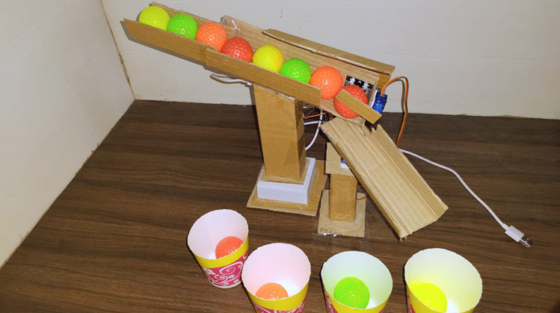
OUTPUT OF PROJECT

Slide 17

RESULT
The objects are sorted with respect to their color Sorting and dropped into the respective bins. The use of automation in color determination Sorting objects process becomes simple due to which counting, and sorting process reduced manual efforts. This leads to improving accuracy as well as save money and time.

